Slide 1
Predictive Analysis of Health Insurance Claim Approvals

Slide 2
The Challenge:
Manual claim processing is cumbersome, error-prone, and slow, leading to dissatisfaction among stakeholders.
Current average claim processing time significantly exceeds the industry standard for timeliness.
Inconsistencies in claims outcomes affect customer trust and insurer reliability.
The Need for Automation:
Automation using predictive models can drastically reduce claim processing times and enhance accuracy.
Predictive analytics can lead to more efficient resource allocation and better customer experiences.
It represents an opportunity to minimize operational costs while maximizing service quality.

Slide 3
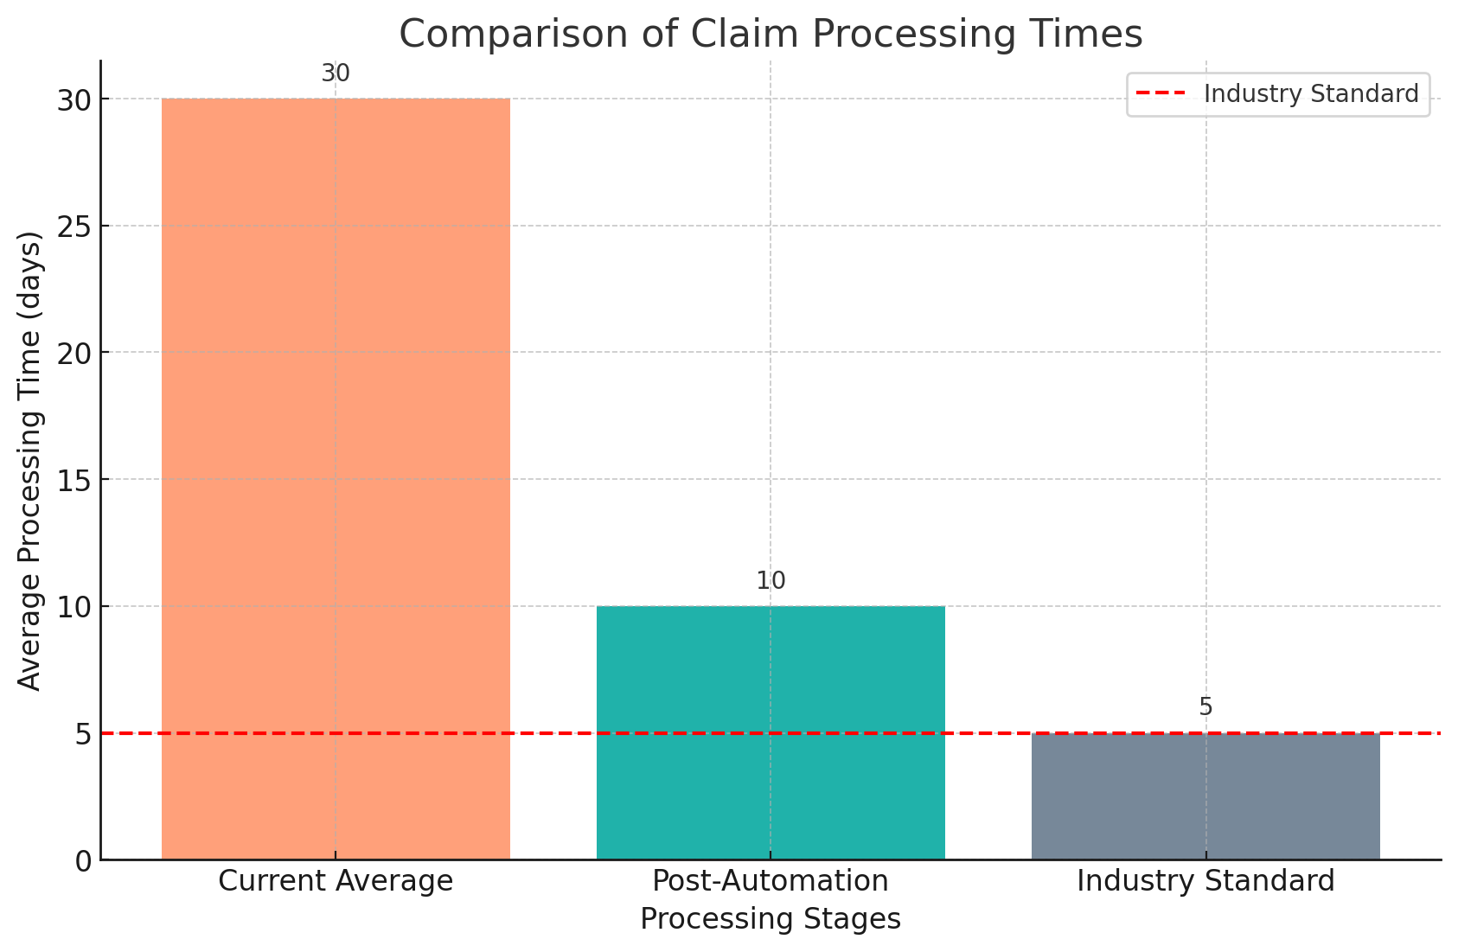
Here's a graph that visually represents the average processing time of health insurance claims. The bar graph compares the current average processing time with the potential improvements that could be achieved through the implementation of automation via predictive modeling, alongside the industry standard for quick processing times.

Slide 4
Our Objective
Develop a machine learning model capable of accurately predicting insurance claim outcomes.
The model aims to support preemptive decision-making, improving workflow and policyholder satisfaction.
By leveraging data, we strive to transform the claims approval process into a seamless experience.

Slide 5
About Dataset
Mandate Origin: Data collection required by Washington State's ESSB 6404.
Purpose: Used by carriers to review medical necessity of health care services.
Coverage: Includes data on inpatient and outpatient services for medical/surgical procedures, mental health and substance disorders, plus diabetes supplies and durable medical equipment.
Key Reporting Features:
Top 10 codes for prior authorization requests and their approval percentages.
Codes with high initial denials and later approvals upon appeal.
Average response time in hours for different types of decisions.
Data Attributes: Aggregated and de-identified, reflecting comprehensive prior authorization activities across individual and group health plans.

Slide 6
Methodology
Data Preparation:
Cleaning: Addressed missing values, duplicates, and data inconsistencies.
Selection: Chose key features like service codes, approval rates, and response times for predictive relevance.
Transformation: Normalized numerical data and applied one-hot encoding to categorical variables.
Model Development:
Algorithm: Selected logistic regression for its efficiency in binary classification.
Training: Utilized 80% of the data for training with cross-validation to fine-tune parameters.
Validation: Measured model performance using accuracy and AUC metrics.
Predictive Model Implementation:
Integration: Deployed the model into a simulated workflow for real-time predictions.
Testing: Validated model robustness through tests mimicking real-world claim scenarios.

Slide 7
Results
Model Performance:
Accuracy: Achieved an accuracy of 90.57% on the test set, indicating strong predictive capabilities.
Interpretation: High accuracy demonstrates the model's effectiveness in correctly predicting the approval or denial of claims based on the data provided.
Model Deployment:
Model Serialization: Utilized joblib to save the trained logistic regression model as insurance_claim_predictor_model.pkl for easy loading and reuse.
Feature Storage: Saved the names of the features used in the model into feature_names.pkl for consistency in future predictions.
Feature Importance Extraction:
Extracted and saved the feature importances (coefficients) of the logistic regression model, providing insights into which features most strongly influence the prediction of claim outcomes.
These importances are stored in feature_importances.pkl, allowing for easy review and analysis.

Slide 8
Deploying Our Predictive Model with Streamlit
Deployed the web application using npx localtunnel for online access without traditional hosting.
Preprocessed user input to align with the model's training data format to ensure accuracy.
Designed a user-friendly interface with Streamlit widgets for entering data like Carrier, Service Category, and Approval Rates.
Enabled real-time predictions of claim approval probabilities when users submit their data.
Included a slider for users to adjust the decision threshold, which changes the sensitivity of the predictive results.
Displayed output shows the probability of approval and a final decision of "Approved" or "Not Approved" based on the selected threshold.
Application can be launched with the command: streamlit run app.py & npx localtunnel --port 8501.

Slide 9
DEMO IN CLASS

Slide 10
Future Enhancement
Integration with Database: Incorporate a database to store user inputs and predictions, enabling historical analysis and trend identification.
Real-Time Updates: Implement live data updates and dynamic visualizations to reflect changes in the model's predictions and performance over time.
Advanced Model Algorithms: Explore more sophisticated machine learning algorithms beyond logistic regression to improve prediction accuracy and robustness.
User Authentication: Introduce user authentication features to secure sensitive data and personalize the user experience based on roles or permissions.
Customizable Thresholds: Allow users to set custom decision thresholds based on their specific risk tolerance or business requirements.
Feedback Mechanism: Incorporate a feedback mechanism for users to provide input on prediction accuracy, helping to refine the model further.
Error Handling: Implement comprehensive error handling mechanisms to gracefully handle unexpected inputs or server errors.
Scalability: Design the application architecture to scale seamlessly with increasing user traffic and data volume.
Mobile Optimization: Optimize the user interface for mobile devices to ensure a smooth experience for users accessing the application on smartphones or tablets.
Comprehensive Documentation: Provide detailed documentation and user guides to facilitate easy onboarding and usage for new users.

Slide 11
THANK YOU

